Slide 1
Branching and Release Strategy for IaC
Erick Moore, Sr Cloud Solution Architect @ Microsoft

Slide 2
Agenda
Infrastructure as Code (IaC)
What is it and benefits
Imperative vs. declarative
Native vs. agnostic
Source Control and Branching
Code versioning
Branching strategies
Why IaC is different
Building a CI/CD IaC Pipeline (This is all live demo!)
Choosing a code repo
Creating a build pipeline
Creating a release pipeline
Cloning our pipelines
Setting branch policies to protect our environment
Adding a custom status policy
Putting it all together

Slide 3
Infrastructure as Code (IaC)

Slide 4


Infrastructure as Code (IaC)
Treat infrastructure the same way we treat code
60x higher change rate success for production deployments
Mean time to restore service 168x faster
50% less time spent remediating security issue
Instantiate rich and complex architectures in minutes
DevOps
$
Notes:
Puppet labs State of Devops Report is where these numbers are from: over 50,000 respondents

Slide 5
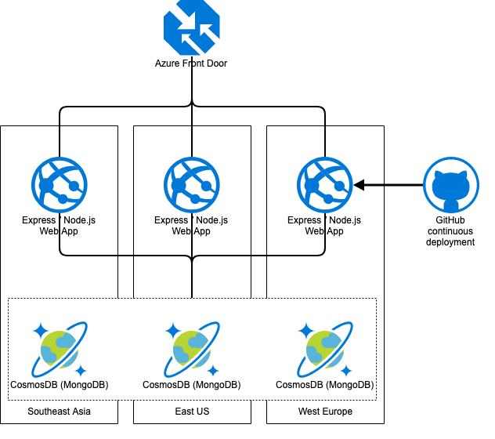
Imperative vs. Declarative
Imperative
Describes what we will do
Declarative
Describes what we want
az cosmosdb create \
-n $cosmosAccountName \
-g $resourceGroupName \
--default-consistency-level Session \
--enable-multiple-write-locations true \
--enable-automatic-failover true \
--kind=MongoDB \
--locations regionName=eastus failoverPriority=0 isZoneRedundant=True \
--locations regionName=westeurope failoverPriority=1 isZoneRedundant=True \
--locations regionName=southeastasia failoverPriority=2 isZoneRedundant=True
# Create a MongoDB database and container
databaseName="invincible-db"
az cosmosdb mongodb database create \
-a $cosmosAccountName \
-g $resourceGroupName \
-n $databaseName
# Retrieve database user, password, and connection string
mongoDbConnectionString=$(az cosmosdb list-connection-strings \
-n $cosmosAccountName \
-g $resourceGroupName \
--query "connectionStrings[?description == 'Primary MongoDB Connection String'].connectionString" \
--output tsv)

Slide 6

Imperative
Mix flour with egg
Roll and knead dough
Cut dough into noodles
Boil water
Put noodles in water for ~5 minutes
Put cooked noodles on plate and serve with sauce

Slide 7

Declarative
I want pasta

Slide 8
Which is Easier?
114 lines of code to deploy this with cli
335 to deploy this with ARM template
Imperative is easier until it’s not…
Change region from East US to East US 2

Slide 9
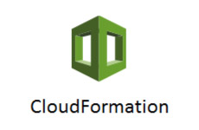
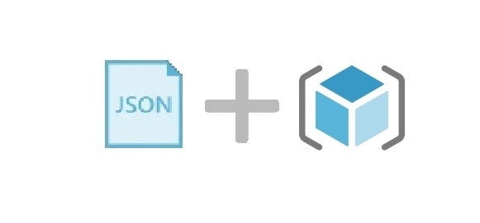
Native vs Agnostic
Native vs Agnostic
Day 1 support for new resource providers (new cloud services)
Pre-flight checks
State does not need to be stored externally (direct access to resource providers)
Tight native integration (CloudTrail, Azure Policy, etc.)

Slide 10

Native vs Agnostic
Native vs Agnostic
Terraform by HashiCorp is the de-facto agnostic IaC tool
Works across all clouds and on-prem as long as there is a resource provider
Can be used to deploy across clouds with ~minor changes
Integrated natively with Azure Cloud Shell

Slide 11

Terraform logo reproduced with permission from Hashicorp
Notes:
This just logically follows from Microsoft Loves Linux.
We work with the HashiCorp Engineers and the community on Open Source provider project
Goal is completely support all Azure resources natively in Terraform

Slide 12
Infrastructure as Code
Reproducible Environments
Automation – CI/ CD
Trackable – Git
Language – YAML/JSON/HCL
All Work is Visible
Don’t sweat the small stuff!! – If you need to mix scripting with templates, do what’s easy and what works.
Notes:
Benefits of IaC

Slide 13
Source Control and Branching

Slide 14

Git SCM as CMDB
Better traceability (CMDB may or may not be accurate based on how or who updates it)
The flow of changes into production can be controlled
Multiple groups can make changes at the same time
All work is visible

Slide 15
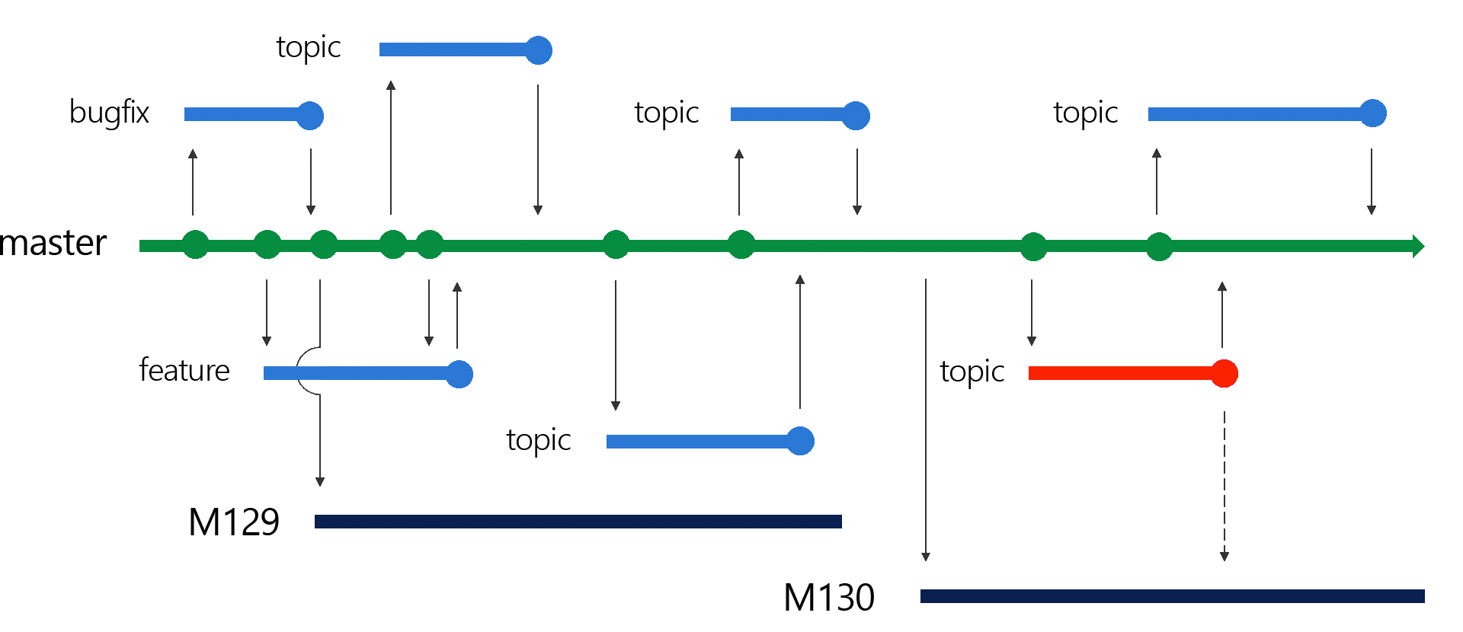
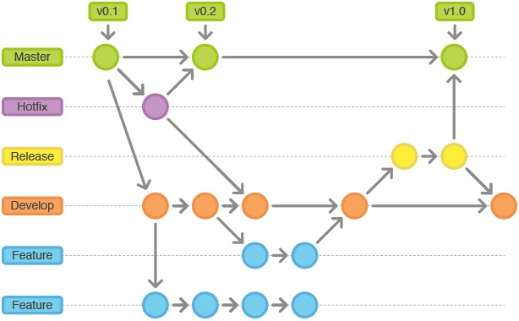
Traditional Branching Strategies
Release Flow
GitFlow
All very development/feature focused
Too complicated for IaC and not necessary
Notes:
https://www.toptal.com/git/git-workflows-for-pros-a-good-git-guide

Slide 16
Environmental Branching
Dev/Non-Prod
QA/Pre-Prod
Prod
{
MERGE
Features
MERGE
Notes:
https://www.toptal.com/git/git-workflows-for-pros-a-good-git-guide

Slide 17
Building CI/CD Pipelines for IaC: Demo

Slide 18
Final Outcome
Allow changes to flow automatically into dev environment with no intervention
Keep the process for deployment simple (single commit/push)
Scan templates for security issues
Protect merge of dev to QA with an approval process
Protect merge of QA into master with an approval process and custom status policy to complete only upon successful deployment
Protect failed deployments into production with automatic rollback to last successful config

